Slide 1

EXERCISES: BLACK-BOX TECHNIQUES
ISTQB – CHAPTER4

Slide 2
Blackbox technique
1
2
3
4
5
Lesson 1.
Equivalence Partitioning
Lesson 2.
Boundary Value Analysis
Lesson 3.
Decision Table Testing
Lesson 4.
State Transition Testing
Lesson 5.
Use-case testing

Slide 3

EQUIVALENCE PARTITIONING/BOUNDARY VALUE ANALYSIS EXERCISE
We will cover these skills:
What is Equivalence Partitioning?
How to do Equivalence Partitioning?
What is Boundary Value Analysis?
How to do Boundary Value Analysis?
Boundary Value Analysis with Equivalence Partitioning

Slide 4
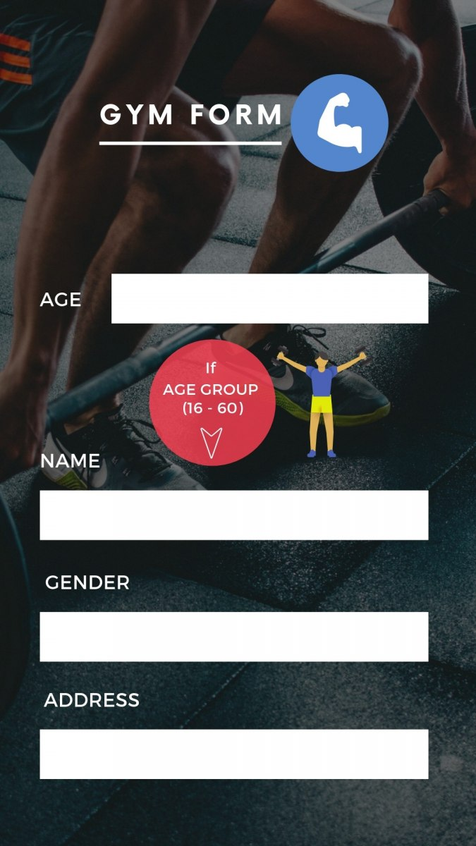
HOW TO DO EQUIVALENCE PARTITIONING AND BOUNDARY VALUE ANALYSIS?
Consider that you are filling an online application form for a gym membership. What are the most important criteria for getting a membership? Of course, the age! Most of the gyms have age criteria of 16-60, where you can independently get the membership without any supervision needed. If you look at below membership form, you will need to fill age first. After that, depending on whether you are between 16-60, you can go further. Otherwise, you will get a message that you cannot get a membership.

Slide 5

EQUIVALENCE PARTITIONING/BOUNDARY VALUE ANALYSIS EXERCISE
Scenario: If you take the train before 9:30 am or in the afternoon after 4:00 pm until 7:30 pm ('the rush hour'), you must pay full fare. A saver ticket is available for trains between 9:30 am and 4:00 pm, and after 7:30 pm.
What are the partitions and boundary values to test the train times for ticket types?
Which are valid partitions and which are invalid partitions? What are the boundary values? (A table may be helpful to organize your partitions and boundaries.) Derive test cases for the partitions and boundaries.
Are there any questions you have about this 'requirement'? Is anything unclear?

Slide 6
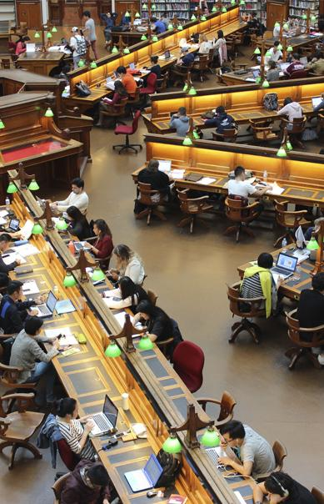

DECISION TABLE TESTING
What is a Decision Table?
How to create a Decision Table?
Examples

Slide 7
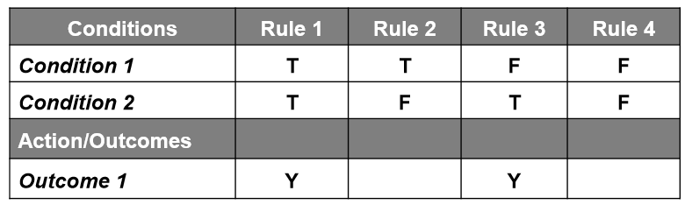
WHAT IS A DECISION TABLE?
A decision table includes rows listing Cause and Effect and columns listing possible combinations. Each combination of conditions in decision table is referred to as a rule and have a corresponding outcome.
Cause also considered as Condition.
Effect also considered as Action or Expected Results.

Slide 8
HOW TO CREATE A DECISION TABLE?
The decision table works on input conditions and actions. That is to say, we create a Table in which the top rows are input conditions, and in the same vein, the bottom rows are resulting actions. Similarly, the columns correspond to unique combinations of these conditions.
Common Notations for Decision Table
For Conditions
Y means the condition is True. We can depict it as T Or 1.
N indicates the condition is False. We can also refer to it as F Or 0.
– It means the condition doesn’t matter. We can represent it as N/A.
For Actions
X means action should occur. We can also refer to it as Y Or T Or 1.
Blank means action should not happen. We can also represent it as N Or F Or 0.

Slide 9

STEPS TO DO
Step 1 – Identify all possible Conditions
Step 2 – Identify the corresponding actions that may occur in the system
Step 3 – Generate All possible Combinations of Conditions
Step 4 – Identify Actions based on the combination of conditions

Slide 10
EXAMPLE 1 – ATM PROCESS
We are going to test the function to withdraw money from an ATM. Here are the conditions for withdrawing money:
1. ATM Card is valid
2. PIN entered is correct (within 3 times)
3. Balance in the account & the machine is enough
Here are the Actions:
● Reject card (if condition 1 failed)
● Eat card (if condition 2 failed)
● Ask new withdrawal amount (if condition 3 failed)
● Pay money (if conditions 1,2 and 3 passed)

Slide 11
EXAMPLE 2 – A SPEEDING FINE SYSTEM
We are going to test the function that decides to fine or not.
If your Speed is 50 or less, nothing happens
If your Speed is larger than 50 and the Zone is not in School Zone, you will be $250 Fined.
If Speed is larger than 50 and the Zone is in School Zone, you will be driving license withdrawal
Request: please find out the Conditions and Actions of above requirement.

Slide 12
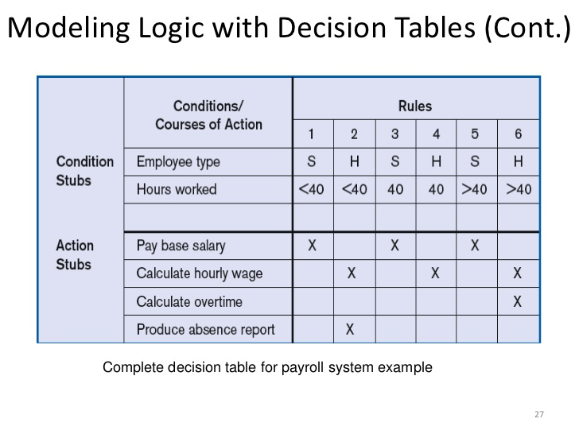
EXAMPLE 3: DECISION TABLE FOR PAYROLL SYSTEM EXAMPLE
Please write test cases to check these conditions

Slide 13
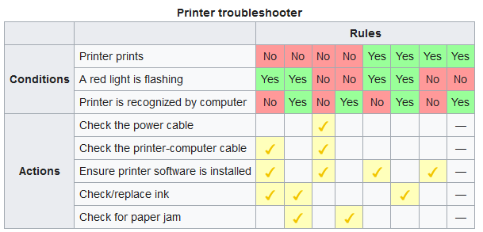
Example 4: Describe in words

Slide 14
EX5: A AIRFARE DISCOUNT EXAMPLE
Request: Read the following spec -> find out the Conditions and Actions of above requirement.
Infant passengers under two years old are offered a discount of 80% on domestic flights
Infant passengers under two years old are offered a discount of 70% on international flights.
Youth passengers (between two and sixteen) are offered a discount of 10%, for any kind of destination.
Frequent flyer enjoys a discount of 20%.
For international flights, passengers are offered 15% discount if they travel during off-seasons.
There would be no discount for international flights, except that when the passenger is an infant passenger or when travelling during off-season.
Passengers who make reservation five months before their journey are offered a discount of 10%.
Frequent flyer enjoys a discount a 15% by making reservation five months before their journey.
The amount of discount is accumulated.
The maximum amount of discount for infant passengers is 80%
The maximum amount of discount for non-infant passengers is 20%
Notes:
https://www.visual-paradigm.com/tutorials/sensible-business-decision-table.jsp

Slide 15

EXAMPLE 06: Draw decision table for this spec
Create a decision table for the following program in an office email system
Send email when Recipient address present, subject present, before 5:30pm
If after 5:30pm then put in pending folder
If Recipient address missing or subject message, give warning message

Slide 16
Example 07
Example 1
No charges are reimbursed to the patient until the deductible has been met. After the deductible has been met, reimburse 50% for Doctor's Office visits or 80% for Hospital visits.
Example 2
No charges are reimbursed to the patient until the deductible has been met. After the deductible has been met, the amount to be reimbursed depends on whether or not the doctor or hospital is a "Preferred Provider." For preferred providers Doctor's office visits are reimbursed at 65% and Hospital visits are reimbursed at 95%. For other providers reimburse 50% for Doctor's Office visits or 80% for Hospital visits.
Example 3
No charges are reimbursed to the patient until the deductible has been met. Doctor's office visits are reimbursed at 50%, Hospital visits are reimbursed at 80% and Lab visits are reimbursed at 70%.
Example 4
No charges are reimbursed to the patient until the deductible has been met. Hospital visits are reimbursed at 80% and Lab visits are reimbursed at 70%. Doctor's office visits are reimbursed at 90% for "Participating Physicians" or 50% for others. The question of whether the Doctor is a Particpating Physician is only applicable for Doctor's office visits; it is not applicable for Hospital visits or Lab work.

Slide 17
EXAMPLE 8 – An education program (Review)
An education program at a Norwegian University have the following admission requirements:
To obtain a study place, the applicant must have a general academic qualification, the mathematic course R1 from upper secondary school, and GPA above the limit of the year.
If the applicant's GPA are below the limit, the individual is put into the waiting list, assuming that he/she have a general academic qualification and have taken R1.
If the applicant has a general qualification, but not taken the mathematics course, the applicant is offered a preparatory course in mathematics, assuming that the GPA are above the limit.
How many conditions are there?
How many Result/Actions are there?
Draw the decision table which shows all possible combinations
Simplify the decision table and reduce the number of rules while retaining the same functionality

Slide 18
Write Test Cases Based On Scenario 01
Scenario: If you hold an 'over 60s' rail card, you get a 34% discount on whatever ticket you buy. If you are traveling with a child (under 16), you can get a 50% discount on any ticket if you hold a family rail card, otherwise you get a 10% discount. You can only hold one type of rail card. Produce a decision table showing all the combinations of fare types and resulting discounts and derive test cases from the decision table.

Slide 19
Write Test Cases Based On Scenario
At one of the interview I got this question, Write as many test cases as you can for this scenario
If you are a new customer and you want to open a credit card account then there are three conditions.
first you will get a 15% discount on all your purchases today.
second if you are an existing customer and you hold a loyalty card, you get a 10% discount.
And third if you have a coupon, you can get 20% off today (but it can’t be used with the ‘new customer’ discount). Discount amounts are added, if applicable.
Can somebody please help me with it.
Notes:
https://www.softwaretestinghelp.com/how-to-write-test-cases-for-a-given-scenario/

Slide 20
Python example
1. Write a Python program to print the following string in a specific format (see the output). Go to the editor
Sample String : "Twinkle, twinkle, little star, How I wonder what you are! Up above the world so high, Like a diamond in the sky. Twinkle, twinkle, little star, How I wonder what you are" Output :
Twinkle, twinkle, little star,
How I wonder what you are!
Up above the world so high,
Like a diamond in the sky.
Twinkle, twinkle, little star,
How I wonder what you are
print("Twinkle, twinkle, little star, \n\tHow I wonder what you are! \n\t\tUp above the world so high, \n\t\tLike a diamond in the sky. \nTwinkle, twinkle, little star, \n\tHow I wonder what you are!")

Slide 21

STATE TRANSITION TESTING
A state is a condition (attribute) in which a system or a component is waiting for one or more events.
A state transition changes in the attributes (from a state to another) of an object caused by an event.
A event is something that causes the system to change state.
An action is an operation initiated because of a state change. Note that action only occurs on transitions between states.
Examples

Slide 22
SCENARIO 1: A WEBSITE SHOPPING
A website shopping basket starts out as empty. As purchases are selected, they are added to the shopping basket. Items can also be removed from the shopping basket. When the customer decides to check out, a summary of the items in the basket and the total cost are shown, for the customer to say whether this is OK or not. If the contents and price are OK, then you leave the summary display and go to the payment system. Otherwise you go back to shopping (so you can remove items if you want).
a. Produce a state diagram showing the different states and transitions. Define a test, in terms of the sequence of states, to cover all transitions.
b. Produce a state table. Give an example test for an invalid transition.

Slide 23
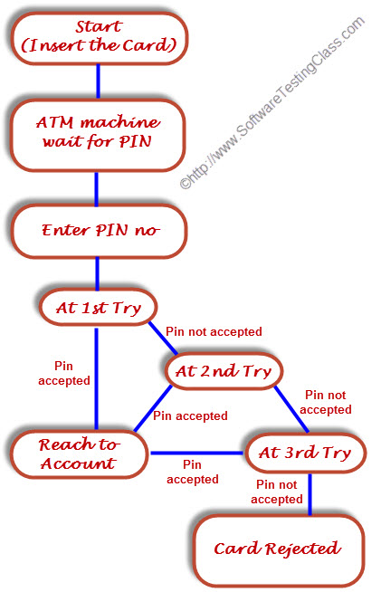
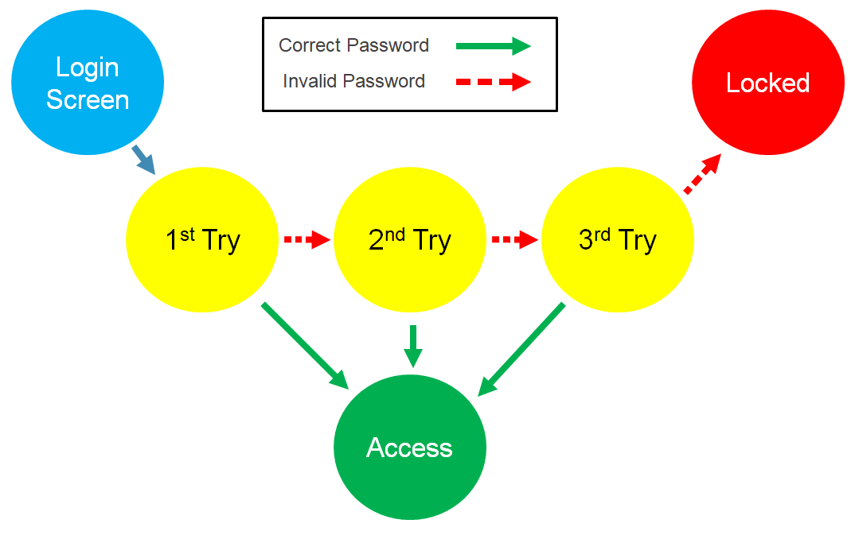
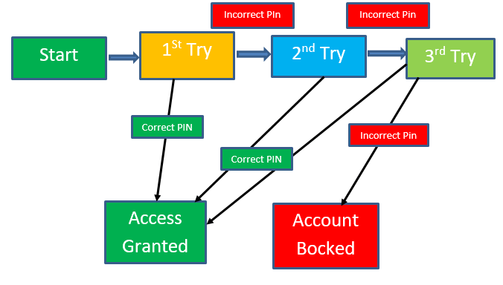
SCENARIO 2: HOW MANY TEST CASES TO COVER ALL STATE TRANSITION?

Slide 24
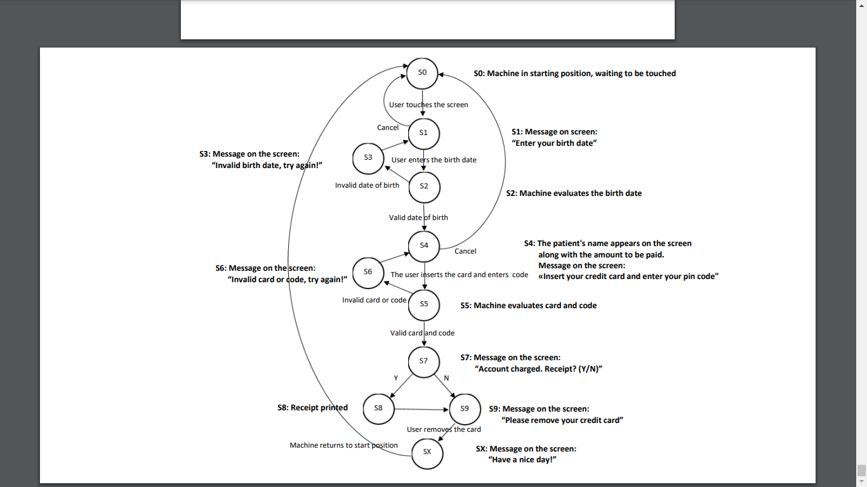
SCENARIO 3: HOW MANY TEST CASES TO COVER ALL STATE TRANSITION?

Slide 25
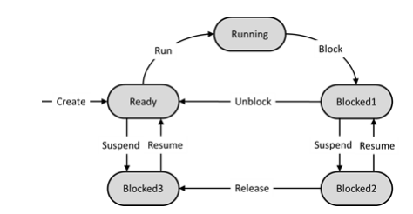
Example 04
The following state transition diagram describes the behavior of a generic scheduler of an Operating System (OS):
Assume a test always starts in the “Ready” state and ends when the system returns to the “Ready” state, so a test input consists of a sequence (“Ready”, event, next state, …, event, “Ready”), where all states except first and last one is different than “Ready”.
What is the MINIMUM number of tests needed to achieve 1-switch coverage?
a) 2
b) 3
c) 4
d) 5
Select ONE answer

Slide 26
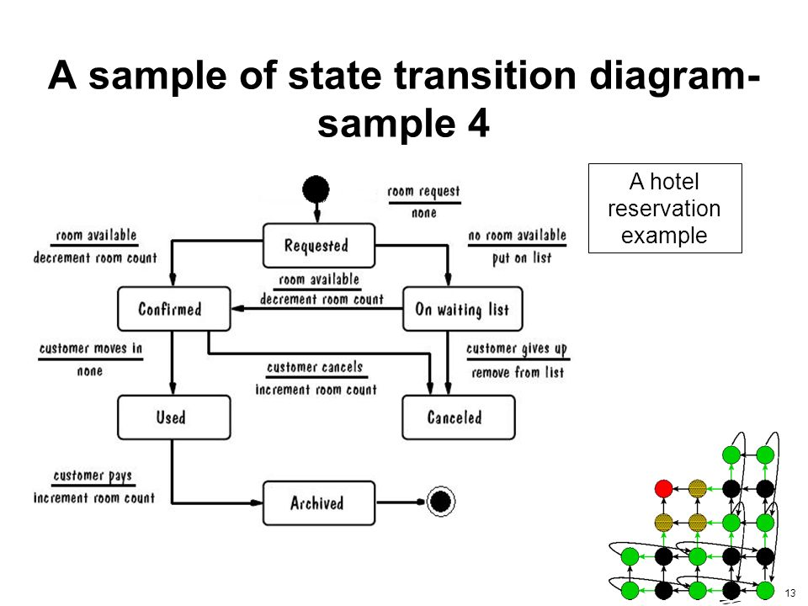
EXAMPLE 4: HOW MANY TEST CASES TO COVER THIS STATE TRANSITION DIAGRAM?

Slide 27

WRITING TEST CASES FROM USER STORIES & ACCEPTANCE CRITERIA
Process:
Business creates requirements and acceptance criteria for a user story.
QA reviews and begins writing test cases.
While examining test cases, QA identifies a scenario that is not covered by the requirements.
QA communicates the scenario to the Business Analyst.
The BA realizes a change to requirements.

Slide 28
STATEMENT AND DECISION TESTING EXERCISE
Scenario: A vending machine dispenses either hot or cold drinks. If you choose a hot drink (e.g. tea or coffee), it asks if you want milk (and adds milk if required), then it asks if you want sugar (and adds sugar if required), then your drink is dispensed.
a. Draw a control flow diagram for this example. (Hint: regard the selection of the type of drink as one statement.)
b. Given the following tests, what is the statement coverage achieved? What is the decision coverage achieved?
Test 1: Cold drink Test
2: Hot drink with milk and sugar
c. What additional tests would be needed to achieve 100% statement coverage? What additional tests would be needed to achieve 100% decision coverage?

Slide 29
EXAMPLE USER STORY & ACCEPTANCE CRITERIA
As a recurring customer, I want to reorder items from my previous orders so I don’t have to search for them each time.
Acceptance Criteria 1: Order history option is displayed on accounts page.
Acceptance Criteria 2: Previously purchased items are displayed when clicking on order history.
Acceptance Criteria 3. User may add previously ordered items to the cart.
Request:
1. Think about the Workflow
2. Create the Happy Path
3. Negative Testing: What are all the possible error cases that can happen?
4. Boundaries:??

Slide 30
A Tester Walks into a Bar: Reviewing Test Techniques
Summary:
A tester walks into a bar and orders a beer. Then he orders ten beers, negative one beer, zero beers ... There are many variations of this joke. So let's try to think of every variation! Continuing the scenario of ordering beers at a bar, let's build test cases for how we would test the beer-ordering process as though it were software.
You know this joke, right? A tester walks into a bar and orders a beer. Then he orders ten beers, negative one beer, and so on. There are many variations.
Based on the joke, let’s do an exercise to build test cases for each scenario. It will put your testing techniques through their paces, and it will be fun!

Slide 31
Equivalence partitioning and Boundary value Analysis? Think about the number of beer bottles that a person can order?
The first test cases will be easy, using equivalence partitioning.
The only valid partition is a range of integers, starting from one beer. But what’s the upper limit of this range? Theoretically, it can be infinite, because there are no rules printed on the wall of any bar stating how many beers you can order. Still, we have to consider real-life restrictions, like how many beers can a bar store and what’s the highest number of beers a group of friends would order at the same time. Based on this reasoning, I think a dozen would be a pretty good upper limit of the valid equivalence partition.

Slide 32
Decision table? Think about the condition to serve beer at the bar?
Suppose that the service is applied (can order beer) when the person meets the following conditions:
Over 18 years old and allowed to drink beer.
Not sick (not allowed to drink alcohol).

Slide 33
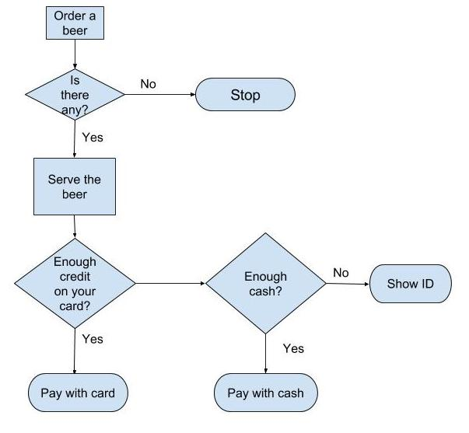
State Transition
You can test the beer ordering process
with state transition diagram?

Slide 34
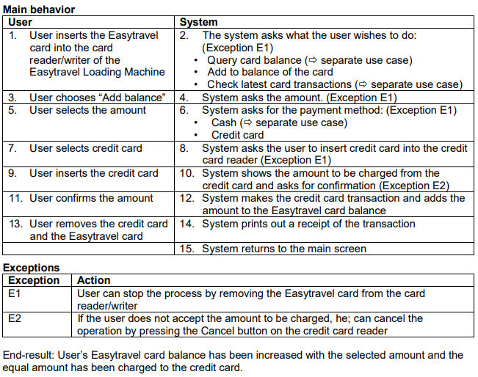
Use-case Testing
Easytravel is a card which is used to paying for journeys on buses and subways. The user can store credit to the card at the Easytravel Loading Machines and the system automatically deducts the journey fee when the user inserts the card into the card reader/writer on a bus or at the subway station. You are a member of the Easytravel project team, and the following user story has been given to you for reviewing.
USE CASE: ADD TO EASYTRAVEL BALANCE FROM CREDIT CARD Use case ID: UC-201201
Purpose: User is increasing the balance on their Easytravel card .
Actors: user, system Pre-conditions: User has a valid Easytravel card and a credit card.
Practice:
How many test cases are required to achieve the minimum coverage for this use case?
Write test cases

Slide 36
THANK YOU!

